Slide 1
NT219- Cryptography
Week 6: Modern Asymmetric Ciphers
PhD. Ngoc-Tu Nguyen
tunn@uit.edu.vn

Slide 2
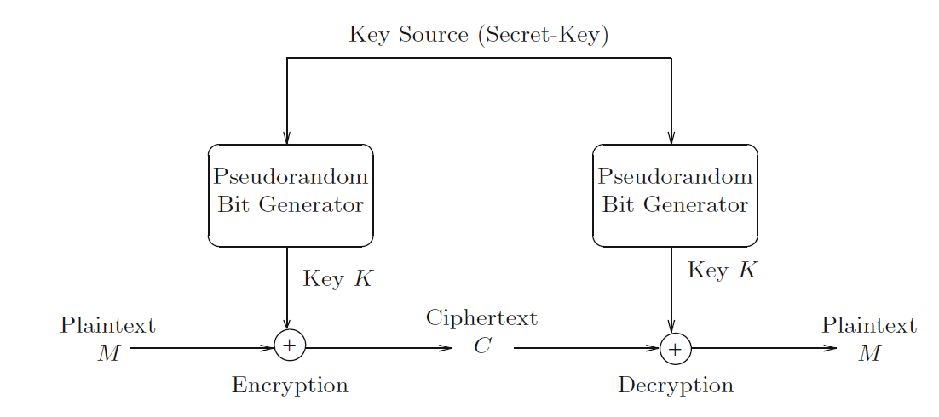
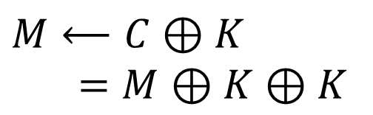

Stream Cipher Review
How to negotiate?
Chaotic
system for ex.
One-time key!
$$M⟵C⊕K$$
$=M$ $⊕K$ $⊕K$
$$C←M⊕K$$
Attacks (chosen plaintext attacks):
$Known \left(M, C\right): C⊕M=$ $M⊕K⊕M=K$

Slide 3
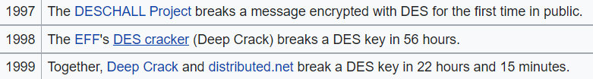
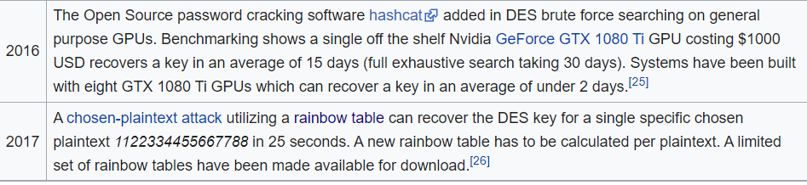
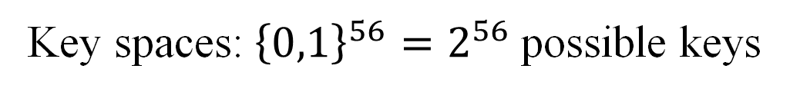
DES review
DES: 64-bits block cipher
Key spaces: ${\left\{0,1\right\}}^{56}=2^{56}$possible keys
Unsecure!
Brute Force attacks
Choosen
plaintext attacks!
https://en.wikipedia.org/wiki/Data_Encryption_Standard

Slide 4
A E S review
substitute-bytes (sub)
Non-linear operation based on a defined substitution box
Used to resist cryptanalysis and other mathematical attacks
shift-rows (shr)
Linear operation for producing diffusion
mix-columns (mic)
Elementary operation also for producing diffusion
add-round-key (ark) (128, 192, 256 bits)
Simple set of ⊕ operations on state matrices
Linear operation
Produces confusion

Slide 5
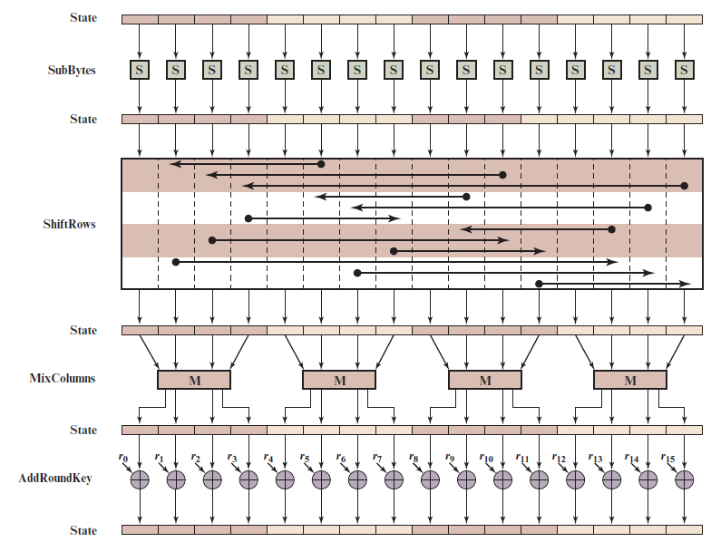
Dynamic AES?
Negotiate
the secret key?
Notes:
Figure 6.4 depicts the structure of a full encryption round.

Slide 6
A E S review
Negotiate
the secret key?
Notes:
Figure 6.4 depicts the structure of a full encryption round.

Slide 7
Outline
Why asymmetric cryptography?
Factoring Based Cryptography (P1)
RSA
Rabin
Logarithm Based Cryptography (P2)
Elliptic Curve Cryptography (P3)
Some advanced cryptography system (quantum resistance)
Notes:
Cipher=a secret system of writing;

Slide 8
Why Public-Key Cryptosystems?
To ove :
Key distribution (key for sysmetric encryption)
How to have secure communications in general without having to trust a KDC with your key
Digital signatures
How to verify that a message comes intact from the claimed sender
Whitfield Diffie and Martin Hellman: proposed a method that addressed both problems (1976)

Slide 9
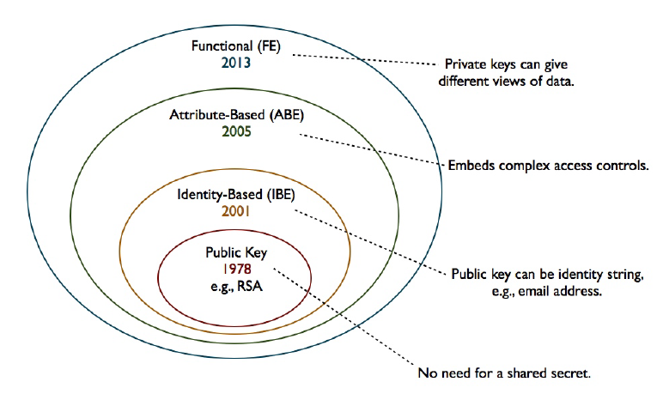





Moden Asymmetric ciphers
Symmetric cipher vs Asymmetric cipher
Hommophic, Searchable encryption,..
$ID_{A}(atributes)$
$ID_{B}(atributes)$
$$(PK_{A}, \{SK_{A},SK_{B},..\})$$
ID
$$(PK_{A}, SK_{A})$$
$$(PK_{A}, SK_{A})$$

Slide 10
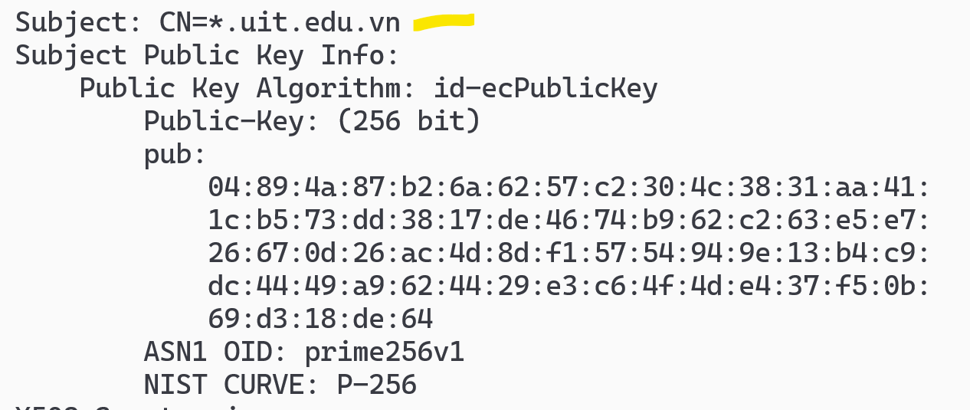
Web’s Server Public Key
openssl s_client -connect <server>:<port> -showcerts
openssl s_client -connect google.com:443 –showcerts
View in X590 format
openssl s_client -connect uit.edu.vn:443 -showcerts 2>NUL | openssl x509 -text -noout

Slide 11
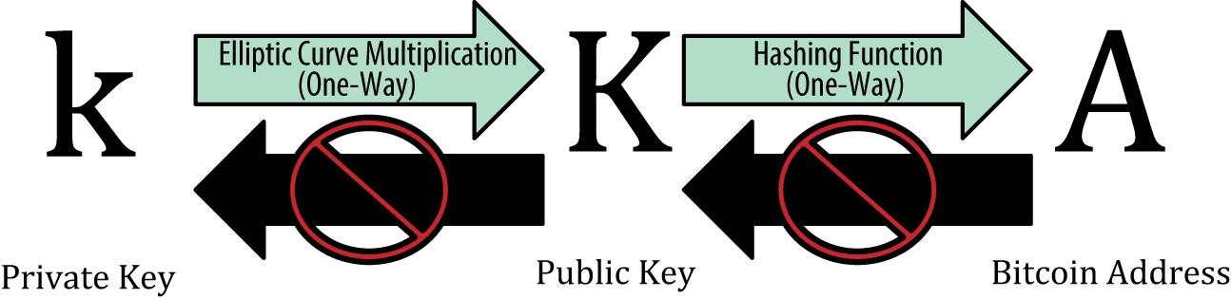
Example

Slide 12
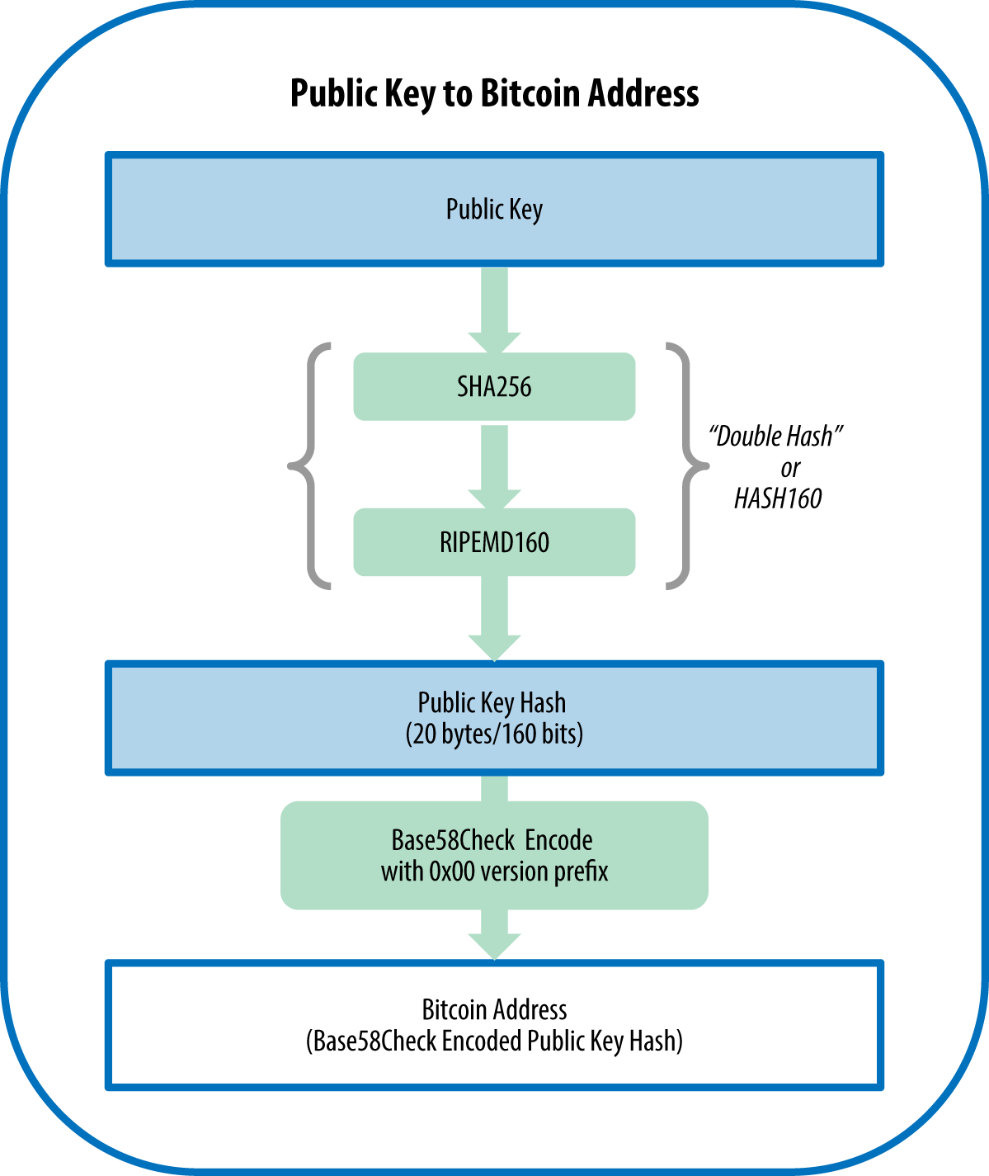
Example

Slide 13
Public-Key Cryptosystems
A public-key encryption scheme has six ingredients:
Plaintext
The readable message or data that is fed into the algorithm as input
Encryption algorithm
Performs various transforma-tions on the plaintext
Public key
Used for encryption or decryption
Private key
Used for encryption or decryption
Ciphertext
The scrambled message produced as output
Decryption algorithm
Accepts the ciphertext and the matching key and produces the original plaintext
Notes:
Asymmetric algorithms rely on one key for encryption and a different but related
key for decryption. These algorithms have the following important characteristic.
• It is computationally infeasible to determine the decryption key given only
knowledge of the cryptographic algorithm and the encryption key.
In addition, some algorithms, such as RSA, also exhibit the following characteristic.
• Either of the two related keys can be used for encryption, with the other used
for decryption.
A public-key encryption scheme has six ingredients (Figure 9.1a; compare
with Figure 3.1).
• Plaintext: This is the readable message or data that is fed into the algorithm as
input.
• Encryption algorithm: The encryption algorithm performs various transformations
on the plaintext.
• Public and private keys: This is a pair of keys that have been selected so that
if one is used for encryption, the other is used for decryption. The exact transformations
performed by the algorithm depend on the public or private key
that is provided as input.
• Ciphertext: This is the scrambled message produced as output. It depends on
the plaintext and the key. For a given message, two different keys will produce
two different ciphertexts.
• Decryption algorithm: This algorithm accepts the ciphertext and the matching
key and produces the original plaintext.

Slide 14
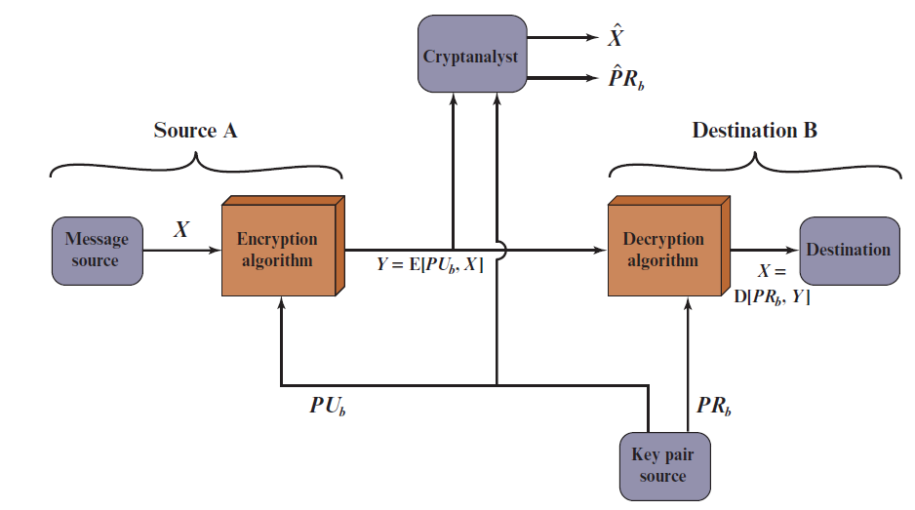
Public-Key Cryptosystem: Confidentiality
Public-Key Cryptosystem: Confidentiality
Notes:
Let us take a closer look at the essential elements of a public-key encryption
scheme, using Figure 9.2 (compare with Figure 3.2).
The scheme illustrated in Figure 9.2 provides confidentiality.

Slide 15
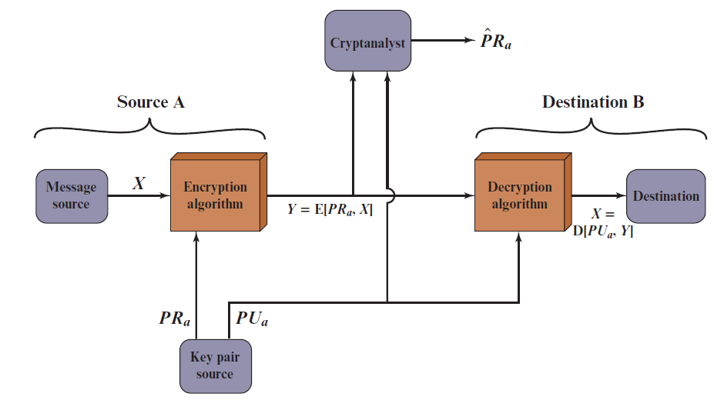
Public-Key Cryptosystem: Data Authentication
Public-Key Cryptosystem: Authentication
Notes:
We mentioned earlier that either of the two related keys can be used for encryption,
with the other being used for decryption. This enables a rather different
cryptographic scheme to be implemented. Whereas the scheme illustrated in
Figure 9.2 provides confidentiality, Figures 9.1b and 9.3 show the use of public-key
encryption to provide authentication.
It is important to emphasize that the encryption process depicted in
Figures 9.1b and 9.3 does not provide confidentiality. That is, the message being
sent is safe from alteration but not from eavesdropping. This is obvious in the
case of a signature based on a portion of the message, because the rest of the
message is transmitted in the clear. Even in the case of complete encryption,
as shown in Figure 9.3, there is no protection of confidentiality because any
observer can decrypt the message by using the sender’s public key.

Slide 16
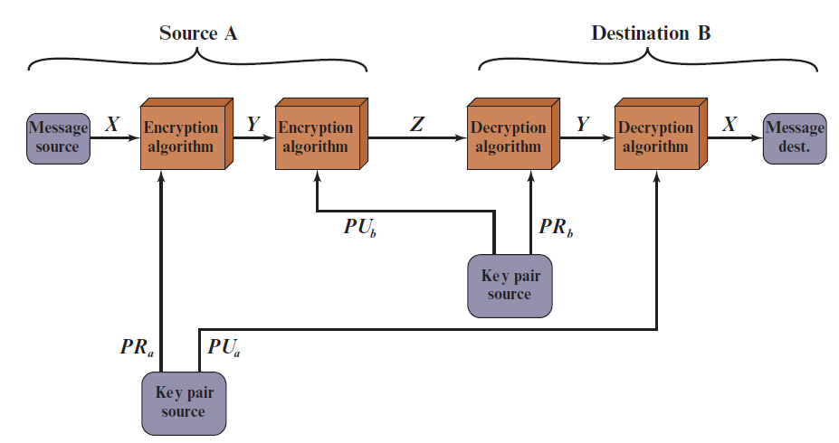
Public-Key Cryptosystem: Authentication and Secrecy
Public-Key Cryptosystem: Authentication and Secrecy
Notes:
It is, however, possible to provide both the authentication function and confidentiality
by a double use of the public-key scheme (Figure 9.4).
In this case, we begin as before by encrypting a message, using the sender’s private
key. This provides the digital signature. Next, we encrypt again, using the receiver’s
public key. The final ciphertext can be decrypted only by the intended receiver, who
alone has the matching private key. Thus, confidentiality is provided. The disadvantage
of this approach is that the public-key algorithm, which is complex, must be
exercised four times rather than two in each communication.

Slide 17
Applications for Public-Key Cryptosystems
Public-key cryptosystems can be classified into three categories:
Encryption/decryption
The sender encrypts a message with the recipient’s public key
Digital signature
The sender “signs” a message with its private key
Key exchange
Two sides cooperate to exchange a session key
Some algorithms are suitable for all three applications, whereas others can be used only for one or two

Slide 18
Applications for Public-Key Cryptosystems
Algorithm | Encryption/Decryption | Digital Signature | Key Exchange
RSA | Yes | Yes | Yes
Elliptic Curve | Yes | Yes | Yes
Diffie–Hellman | No | No | Yes
DSS | No | Yes | No

Slide 19
Public-Key Requirements
Cryptology= Cryptography + Cryptanalysis
Secret writing (cipher)
How?
“One-way function”
“Readable data”
“Unreadable data”
Plaintext
Ciphertext
Easy to compute
“Hard” to compute

Slide 20
Public-Key Requirements (1 of 2)
Conditions that these algorithms must fulfill:
It is computationally easy for a party B to generate a pair (public-key P U_{b}, private key P R_{b})
It is computationally easy for a sender A, knowing the public key and the message to be encrypted, to generate the corresponding ciphertext
It is computationally easy for the receiver B to decrypt the resulting ciphertext using the private key to recover the original message
It is computationally infeasible for an adversary, knowing the public key, to determine the private key
It is computationally infeasible for an adversary, knowing the public key and a ciphertext, to recover the original message
The two keys can be applied in either order
Notes:
The cryptosystem illustrated in Figures 9.2 through 9.4 depends on a cryptographic algorithm based on two related keys. Diffie and Hellman postulated this system without demonstrating that such algorithms exist. However, they did lay out the conditions that such algorithms must fulfill: [DIFF76b].
It is computationally easy for a party B to generate a pair (public key PU_{b}, private key PR_{b}).
It is computationally easy for a sender A, knowing the public key and the message to be encrypted, M, to generate the corresponding ciphertext:
C = E(PU_{b}, M)
3. It is computationally easy for the receiver B to decrypt the resulting ciphertext using the private key to recover the original message:
M = D(PR_{b}, C) = D[PR_{b}, E(PU_{b}, M)
4. It is computationally infeasible for an adversary, knowing the public key, PU_{b}, to determine the private key, PR_{b}
5. It is computationally infeasible for an adversary, knowing the public key, PU_{b}, and a ciphertext, C, to recover the original message, M.
6. The two keys can be applied in either order:
M = D[PU_{b} , E(PR_{b}, M)] = D[PR_{b}, E(PU_{b}, M)]
These are formidable requirements, as evidenced by the fact that only a few algorithms (RSA, elliptic curve cryptography, Diffie-Hellman, DSS) have received widespread acceptance in the several decades since the concept of public-key cryptography was proposed.

Slide 21
Public-Key Requirements (2 of 2)
Need a trap-door one-way function
A one-way function is one that maps a domain into a range such that every function value has a unique inverse, with the condition that the calculation of the function is easy, whereas the calculation of the inverse is infeasible
Y = f(X) easy
X = f^{–1}(Y) infeasible
A trap-door one-way function is a family of invertible functions f_{k}, such that
Y = f_{k}(X) easy, if k and X are known
X = f_{k}^{–1}(Y) easy, if k and Y are known
X = f_{k}^{–1}(Y) infeasible, if Y known but k not known
A practical public-key scheme depends on a suitable trap-door one-way function

Slide 22
Outline
Why asymmetric cryptography?
Factoring Based Cryptography (P1)
RSA
Rabin
Logarithm Based Cryptography (P2)
Elliptic Curve Cryptography (P3)
Some advanced cryptography system (quantum resistance)
Notes:
Cipher=a secret system of writing;

Slide 23
Rivest-Shamir-Adleman (R S A) Algorithm
Developed in 1977 at M I T by Ron Rivest, Adi Shamir & Len Adleman
Most widely used general-purpose approach to public-key encryption
Is a cipher in which the plaintext and ciphertext are integers between 0 and n – 1 for some n
A typical size for n is 3072 bits

Slide 24
Cryptograph review
Cryptology= Cryptography + Cryptanalysis
Secret writing
How?
“One-way function”
“Readable data”
“Unreadable data”
Plaintext
Ciphertext
Easy to compute
“Hard” to compute

Slide 25
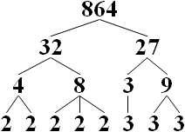
Prime factorization problem
Factorize number
N = 864
= 2⁵ × 3³
Input: n-bits composite number N
Output:
No classical algorithm has been published that can factor all integers in polynomial time.
https://en.wikipedia.org/wiki/Integer_factorization

Slide 26
Prime factorization problem
“Prime factorization one-way function!”
Input: large prime number and a large number $e$
Easy to compute
$d=e^{−1}\operatorname{mod}{(}p−1)(q−1)$, e.d =1 mode (p-1)(q-1)
C = M ^{e} mod n
Input:
“Hard” to compute
C^{d} mod n=M^{e.d} mod n = M^{e.d mod(p-1)(q-1)} mod n = M

Slide 27
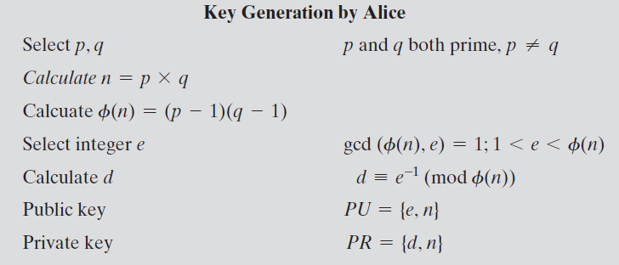
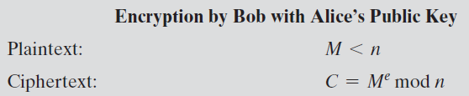
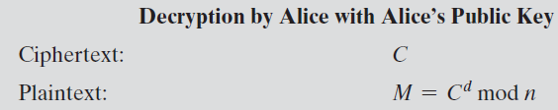

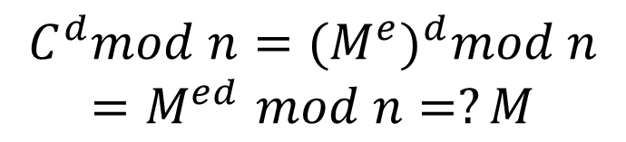
The R S A Algorithm
$$e.d=1 mod φ(n)$$
$$C^{d}mod n={{(M}^{e})}^{d}mod n$$
$${=M}^{ed}mod n=?M$$
Notes:
Figure 9.5 summarizes the RSA algorithm. It corresponds to Figure 9.1a: Alice
generates a public/private key pair; Bob encrypts using Alice’s public key; and Alice
decrypts using her private key.

Slide 28
R S A Algorithm
RSA makes use of an expression with exponentials
Plaintext is encrypted in blocks with each block having a binary value less than some number n
Encryption and decryption are of the following form, for some plaintext block M and ciphertext block C
C = Me mod n
M = C^{d} mod n = (Me)^{d} mod n = M^{ed} mod n
Both sender and receiver must know the value of n
The sender knows the value of e, and only the receiver knows the value of d
This is a public-key encryption algorithm with a public key of PU={e,n} and a private key of PR={d,n}

Slide 29
Algorithm Requirements
For this algorithm to be satisfactory for public-key encryption, the following requirements must be met:
It is possible to find values of e, d, n such that M^{ed} mod n = M for all M < n
It is relatively easy to calculate Me mod n and C^{d} mod n for all values of M < n
It is infeasible to determine d given e and n
Notes:
For this algorithm to be satisfactory for public-key encryption, the following requirements
must be met.
1. It is possible to find values of e, d, and n such that M^{ed} mod n = M for all M < n .
2. It is relatively easy to calculate Me mod n and C^{d} mod n for all values of M < n .
3. It is infeasible to determine d given e and n .

Slide 30
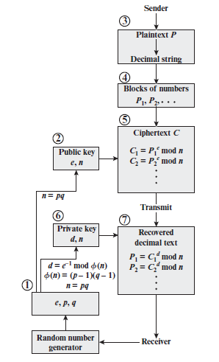
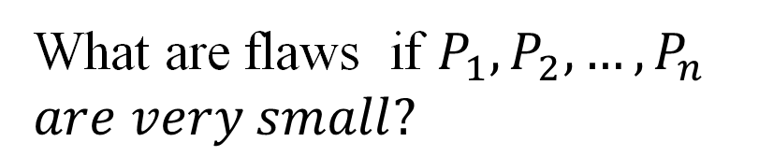
R S A Processing of Multiple Blocks
What are flaws if $P_{1}, P_{2}, …,P_{n}$
$are very small?$

Slide 31
Exponentiation in Modular Arithmetic
Both encryption and decryption in RSA involve raising an integer to an integer power, mod n
Can make use of a property of modular arithmetic:
[(a mod n) x (b mod n)] mod n =(a x b) mod n
With RSA you are dealing with potentially large exponents so efficiency of exponentiation is a consideration
Notes:
Both encryption and decryption in RSA
involve raising an integer to an integer power, mod n . If the exponentiation is done
over the integers and then reduced modulo n , the intermediate values would be
gargantuan. Fortunately, as the preceding example shows, we can make use of a
property of modular arithmetic:
[(a mod n ) * (b mod n )] mod n = (a * b ) mod n
Thus, we can reduce intermediate results modulo n . This makes the calculation
practical.
Another consideration is the efficiency of exponentiation, because with RSA,
we are dealing with potentially large exponents. To see how efficiency might be increased,
consider that we wish to compute x¹⁶ . A straightforward approach requires
15 multiplications:
x¹⁶ = x * x * x * x * x * x * x * x * x * x * x * x * x * x * x * x
However, we can achieve the same final result with only four multiplications if we
repeatedly take the square of each partial result, successively forming (x² , x⁴ , x⁸ , x¹⁶ ).

Slide 32
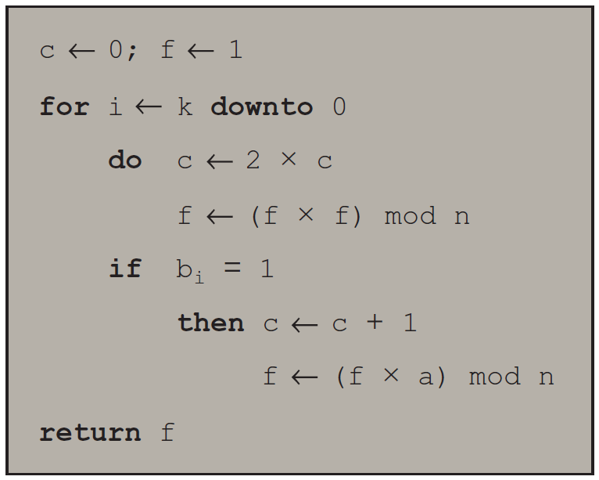

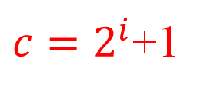


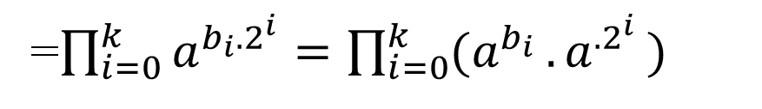
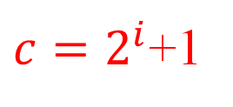
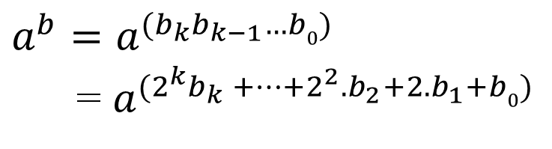

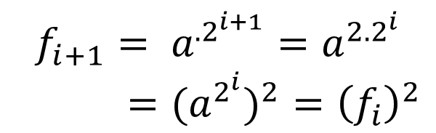

Algorithm for Computing a^{b} mod n
Note: The integer b is expressed as a binary number $b=b_{k}b_{k−1}…b0$
$$a^{b}=a^{(b_{k}b_{k−1}…b0)}$$
= $a^{(2^{k}b_{k} +…+2^{2}.b_{2}+2.b_{1}+b0)}$
=$\prod_{i=0}^{k}{a^{b_{i}.2^{i}}}=\prod_{i=0}^{k}{{(a}^{b_{i} }{.a}^{.2^{i}})}$
$$c=2^{i}$$
$$c=2^{i}$$
$${f_{i}=a}^{.2^{i}}$$
$c=2^{i}$+1
$${f_{i}=a}^{c}$$
$c=2^{i}$+1
$${f_{i+1}= a}^{.2^{i+1}}=a^{{2.2}^{i}}$$
$={{(a}^{2^{i}})}^{2}={\left(f_{i}\right)}^{2}$
$$f_{i+1}={\left(f_{i}\right)}^{2}.a$$
Notes:
We can therefore develop the algorithm for computing a^{b} mod n, shown in
Figure 9.8.

Slide 33
Result of the Fast Modular Exponentiation Algorithm for a^{b} mod n, where a = 7, b = 560 = 1000110000, and n = 561
Algorithm for Computing a^{b} mod n
$$7^{560}=7^{{\left(1000110000\right)}_{2}}=7^{2^{10}}.7^{2^{5}}.7^{2^{4}}$$
i | 9 | 8 | 7 | 6 | 5 | 4 | 3 | 2 | 1 | 0
b_{i} | 1 | 0 | 0 | 0 | 1 | 1 | 0 | 0 | 0 | 0
c | 1 | 2 | 4 | 8 | 17 | 35 | 70 | 140 | 280 | 560
f | 7 | 49 | 157 | 526 | 160 | 241 | 298 | 166 | 67 | 1
Notes:
Table 9.4 shows an example of the execution of this algorithm. Note that the variable c is not needed; it is included for explanatory purposes. The final value of c is the value of the exponent.

Slide 34
Efficient Operation Using the Public Key
To speed up the operation of the R S A algorithm using the public key, a specific choice of e is usually made
The most common choice is 65537 (2¹⁶ + 1)
Two other popular choices are e=3 and e=17
Each of these choices has only two 1 bits, so the number of multiplications required to perform exponentiation is minimized
With a very small public key, such as e = 3, R S A becomes vulnerable to a simple attack

Slide 35
Efficient Operation Using the Private Key
Decryption uses exponentiation to power d
A small value of d is vulnerable to a brute-force attack and to other forms of cryptanalysis
Can use the Chinese Remainder Theorem (C R T) to speed up computation
The quantities d mod (p – 1) and d mod (q – 1) can be precalculated
End result is that the calculation is approximately four times as fast as evaluating M = C^{d} mod n directly
Notes:
We cannot similarly choose a small constant value of d for efficient operation. A small value of d is vulnerable to a brute-force attack and to other forms of cryptanalysis [WIEN90]. However, there is a way to speed up computation using the CRT.
The quantities d mod (p - 1) and d mod (q - 1) can be precalculated. The end
result is that the calculation is approximately four times as fast as evaluating M = C^{d}
mod n directly [BONE02].

Slide 36
Key Generation
Before the application of the public-key cryptosystem each participant must generate a pair of keys:
Determine two prime numbers p and q
Select either e or d and calculate the other
Because the value of n = pq will be known to any potential adversary, primes must be chosen from a sufficiently large set
The method used for finding large primes must be reasonably efficient
Notes:
Before the application of the public-key cryptosystem, each
participant must generate a pair of keys. This involves the following tasks.
• Determining two prime numbers, p and q.
• Selecting either e or d and calculating the other.
First, consider the selection of p and q . Because the value of n = pq will be
known to any potential adversary, in order to prevent the discovery of p and q by
exhaustive methods, these primes must be chosen from a sufficiently large set (i.e.,
p and q must be large numbers). On the other hand, the method used for finding
large primes must be reasonably efficient.
At present, there are no useful techniques that yield arbitrarily large primes,
so some other means of tackling the problem is needed. The procedure that is generally
used is to pick at random an odd number of the desired order of magnitude
and test whether that number is prime. If not, pick successive random numbers until
one is found that tests prime.
A variety of tests for primality have been developed (e.g., see [KNUT98] for
a description of a number of such tests). Almost invariably, the tests are probabilistic.
That is, the test will merely determine that a given integer is probably prime.
Despite this lack of certainty, these tests can be run in such a way as to make the
probability as close to 1.0 as desired. As an example, one of the more efficient
and popular algorithms, the Miller-Rabin algorithm, is described in Chapter 2.
With this algorithm and most such algorithms, the procedure for testing whether
a given integer n is prime is to perform some calculation that involves n and a
randomly chosen integer a . If n “fails” the test, then n is not prime. If n “passes”
the test, then n may be prime or nonprime. If n passes many such tests with many
different randomly chosen values for a , then we can have high confidence that n
is, in fact, prime.

Slide 37
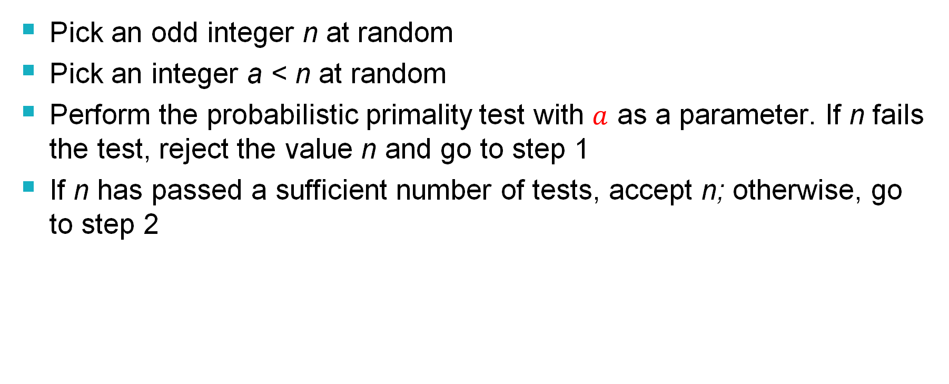
Procedure for Picking a Prime Number
Pick an odd integer n at random
Pick an integer a < n at random
Perform the probabilistic primality test with $a$ as a parameter. If n fails the test, reject the value n and go to step 1
If n has passed a sufficient number of tests, accept n; otherwise, go to step 2
Notes:
In summary, the procedure for picking a prime number is as follows.
1. Pick an odd integer n at random (e.g., using a pseudorandom number
generator).
2. Pick an integer a < n at random.
3. Perform the probabilistic primality test, such as Miller-Rabin, with a as a
parameter. If n fails the test, reject the value n and go to step 1.
4. If n has passed a sufficient number of tests, accept n ; otherwise, go to step 2.

Slide 38
Public-Key Cryptanalysis
A public-key encryption scheme is vulnerable to a brute-force attack
Countermeasure: use large keys
Key size must be small enough for practical encryption and decryption
Key sizes that have been proposed result in encryption/decryption speeds that are too slow for general-purpose use
Public-key encryption is currently confined to key management and signature applications
Another form of attack is to find some way to compute the private key given the public key
To date it has not been mathematically proven that this form of attack is infeasible for a particular public-key algorithm
Finally, there is a probable-message attack
This attack can be thwarted by appending some random bits to simple messages
Notes:
As with symmetric encryption, a public-key encryption scheme is vulnerable to a
brute-force attack. The countermeasure is the same: Use large keys. However, there
is a tradeoff to be considered. Public-key systems depend on the use of some sort of
invertible mathematical function. The complexity of calculating these functions may
not scale linearly with the number of bits in the key but grow more rapidly than that.
Thus, the key size must be large enough to make brute-force attack impractical but
small enough for practical encryption and decryption. In practice, the key sizes that
have been proposed do make brute-force attack impractical but result in encryption/
decryption speeds that are too slow for general-purpose use. Instead, as was mentioned
earlier, public-key encryption is currently confined to key management and
signature applications.
Another form of attack is to find some way to compute the private key given
the public key. To date, it has not been mathematically proven that this form of attack
is infeasible for a particular public-key algorithm. Thus, any given algorithm,
including the widely used RSA algorithm, is suspect. The history of cryptanalysis
shows that a problem that seems insoluble from one perspective can be found to
have a solution if looked at in an entirely different way.
Finally, there is a form of attack that is peculiar to public-key systems. This is,
in essence, a probable-message attack. Suppose, for example, that a message were to
be sent that consisted solely of a 56-bit DES key. An adversary could encrypt all possible
56-bit DES keys using the public key and could discover the encrypted key by
matching the transmitted ciphertext. Thus, no matter how large the key size of the
public-key scheme, the attack is reduced to a brute-force attack on a 56-bit key. This
attack can be thwarted by appending some random bits to such simple messages.

Slide 39
The Security of R S A
Five possible approaches to attacking RSA are:
Brute force
Involves trying all possible private keys
Mathematical attacks
There are several approaches, all equivalent in effort to factoring the product of two primes
Timing attacks
These depend on the running time of the decryption algorithm
Hardware fault-based attack
This involves inducing hardware faults in the processor that is generating digital signatures
Chosen ciphertext attacks
This type of attack exploits properties of the RSA algorithm
Notes:
Five possible approaches to attacking the RSA algorithm are
■ Brute force: This involves trying all possible private keys.
■ Mathematical attacks: There are several approaches, all equivalent in effort to
factoring the product of two primes.
■ Timing attacks: These depend on the running time of the decryption algorithm.
■ Hardware fault-based attack: This involves inducing hardware faults in the
processor that is generating digital signatures.
■ Chosen ciphertext attacks: This type of attack exploits properties of the RSA
algorithm.
The defense against the brute-force approach is the same for RSA as for other cryptosystems, namely, use a large key space. Thus the larger the number of bits in d, the better. However because the calculations involved both in key generation and in encryption/decryption are complex, the larger the size of the key, the slower the system will run.

Slide 40
Timing Attacks
Paul Kocher, a cryptographic consultant, demonstrated that a snooper can determine a private key by keeping track of how long a computer takes to decipher messages
Are applicable not just to RSA but to other public-key cryptography systems
Are alarming for two reasons:
It comes from a completely unexpected direction
It is a ciphertext-only attack
Notes:
If one needed yet another lesson about how difficult it is to
assess the security of a cryptographic algorithm, the appearance of timing attacks
provides a stunning one. Paul Kocher, a cryptographic consultant, demonstrated
that a snooper can determine a private key by keeping track of how long a computer
takes to decipher messages [KOCH96, KALI96b]. Timing attacks are applicable
not just to RSA, but to other public-key cryptography systems. This attack is alarming
for two reasons: It comes from a completely unexpected direction, and it is a
ciphertext-only attack.
A timing attack is somewhat analogous to a burglar guessing the combination
of a safe by observing how long it takes for someone to turn the dial from number
to number. We can explain the attack using the modular exponentiation algorithm
of Figure 9.8, but the attack can be adapted to work with any implementation that
does not run in fixed time. In this algorithm, modular exponentiation is accomplished
bit by bit, with one modular multiplication performed at each iteration and
an additional modular multiplication performed for each 1 bit.

Slide 41
Countermeasures
Constant exponentiation time
Ensure that all exponentiations take the same amount of time before returning a result; this is a simple fix but does degrade performance
Random delay
Better performance could be achieved by adding a random delay to the exponentiation algorithm to confuse the timing attack
Blinding
Multiply the ciphertext by a random number before performing exponentiation; this process prevents the attacker from knowing what ciphertext bits are being processed inside the computer and therefore prevents the bit-by-bit analysis essential to the timing attack
Notes:
Although the timing attack is a serious threat, there are simple countermeasures
that can be used, including the following.
• Constant exponentiation time: Ensure that all exponentiations take the same
amount of time before returning a result. This is a simple fix but does degrade
performance.
• Random delay: Better performance could be achieved by adding a random
delay to the exponentiation algorithm to confuse the timing attack. Kocher
points out that if defenders don’t add enough noise, attackers could still succeed
by collecting additional measurements to compensate for the random delays.
• Blinding: Multiply the ciphertext by a random number before performing
exponentiation. This process prevents the attacker from knowing what ciphertext
bits are being processed inside the computer and therefore prevents the
bit-by-bit analysis essential to the timing attack.

Slide 42
Fault-Based Attack
An attack on a processor that is generating R S A digital signatures
Induces faults in the signature computation by reducing the power to the processor
The faults cause the software to produce invalid signatures which can then be analyzed by the attacker to recover the private key
The attack algorithm involves inducing single-bit errors and observing the results
While worthy of consideration, this attack does not appear to be a serious threat to R S A
It requires that the attacker have physical access to the target machine and is able to directly control the input power to the processor
Notes:
Still another unorthodox approach to attacking RSA is reported
in [PELL10]. The approach is an attack on a processor that is generating
RSA digital signatures. The attack induces faults in the signature computation by
reducing the power to the processor. The faults cause the software to produce invalid
signatures, which can then be analyzed by the attacker to recover the private
key. The authors show how such an analysis can be done and then demonstrate it
by extracting a 1024-bit private RSA key in approximately 100 hours, using a commercially
available microprocessor.
The attack algorithm involves inducing single-bit errors and observing the results.
The details are provided in [PELL10], which also references other proposed
hardware fault-based attacks against RSA.
This attack, while worthy of consideration, does not appear to be a serious
threat to RSA. It requires that the attacker have physical access to the target
machine and that the attacker is able to directly control the input power to the
processor. Controlling the input power would for most hardware require more than
simply controlling the AC power, but would also involve the power supply control
hardware on the chip.

Slide 43
Chosen Ciphertext Attack (C C A)
The adversary chooses a number of ciphertexts and is then given the corresponding plaintexts, decrypted with the target’s private key
Thus the adversary could select a plaintext, encrypt it with the target’s public key, and then be able to get the plaintext back by having it decrypted with the private key
The adversary exploits properties of R S A and selects blocks of data that, when processed using the target’s private key, yield information needed for cryptanalysis
To counter such attacks, R S A Security Inc. recommends modifying the plaintext using a procedure known as optimal asymmetric encryption padding (O A E P)
Notes:
The basic RSA algorithm is vulnerable to a chosen ciphertext attack (CCA). CCA is
defined as an attack in which the adversary chooses a number of ciphertexts and
is then given the corresponding plaintexts, decrypted with the target’s private key.
Thus, the adversary could select a plaintext, encrypt it with the target’s public key,
and then be able to get the plaintext back by having it decrypted with the private
key. Clearly, this provides the adversary with no new information. Instead, the adversary
exploits properties of RSA and selects blocks of data that, when processed
using the target’s private key, yield information needed for cryptanalysis.
To counter such attacks, RSA Security Inc., a leading RSA vendor and former holder
of the RSA patent, recommends modifying the plaintext using a procedure known
as optimal asymmetric encryption padding (OAEP). A full discussion of the threats
and OAEP are beyond our scope; see [POIN02] for an introduction and [BELL94a]
for a thorough analysis. Here, we simply summarize the OAEP procedure.

Slide 44
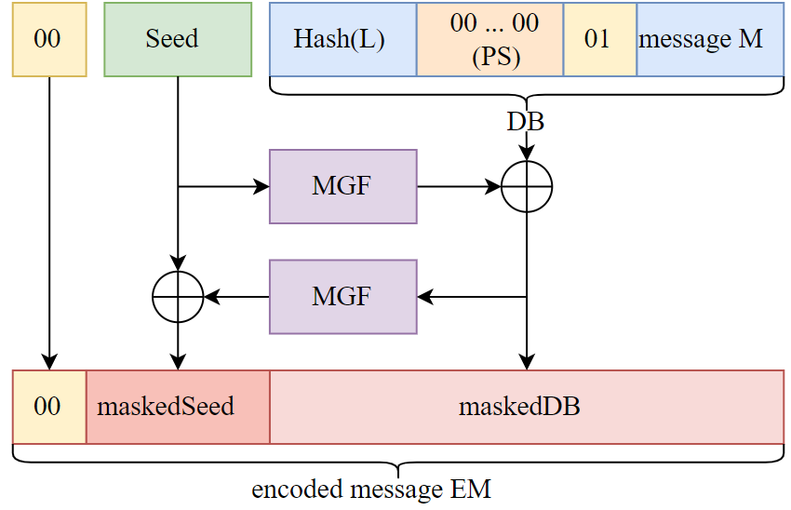
Encryption Using Optimal Asymmetric Encryption Padding (O A E P)
MGF: a hash function

Slide 45
Misconceptions about Public-Key Encryption
Public-key encryption is more secure from cryptanalysis than symmetric encryption
Public-key encryption is a general-purpose technique that has made symmetric encryption obsolete
There is a feeling that key distribution is trivial when using public-key encryption, compared to the cumbersome handshaking involved with key distribution centers for symmetric encryption

Slide 46
Terminology Related to Asymmetric Encryption
Asymmetric Keys Two related keys, a public key and a private key, that are used to perform complementary operations, such as encryption and decryption or signature generation and signature verification.X`
Public Key Certificate A digital document issued and digitally signed by the private key of a Certification Authority that binds the name of a subscriber to a public key. The certificate indicates that the subscriber identified in the certificate has sole control and access to the corresponding private key.
Public Key (Asymmetric) Cryptographic Algorithm A cryptographic algorithm that uses two related keys, a public key and a private key. The two keys have the property that deriving the private key from the public key is computationally infeasible.
Public Key Infrastructure (PKI) A set of policies, processes, server platforms, software and workstations used for the purpose of administering certificates and public-private key pairs, including the ability to issue, maintain, and revoke public key certificates.
Source: Glossary of Key Information Security Terms, NISTIR 7298.
Notes:
Table 9.1 defines some key terms.

Slide 47

Summary
Present an overview of the basic principles of public-key cryptosystems
Explain the two distinct uses of public-key cryptosystems
List and explain the requirements for a public-key cryptosystem
Present an overview of the R S A algorithm
Understand the timing attack
Summarize the relevant issues related to the complexity of algorithms
Notes:
Chapter 9 summary.

